Slide 1
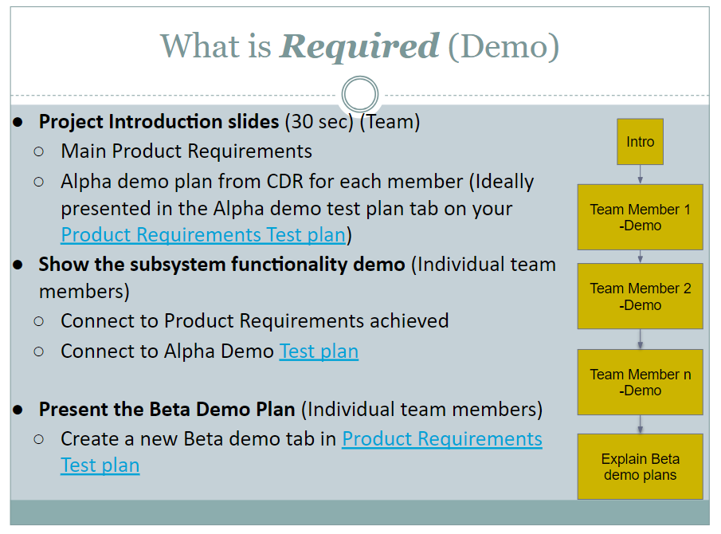

Slide 2
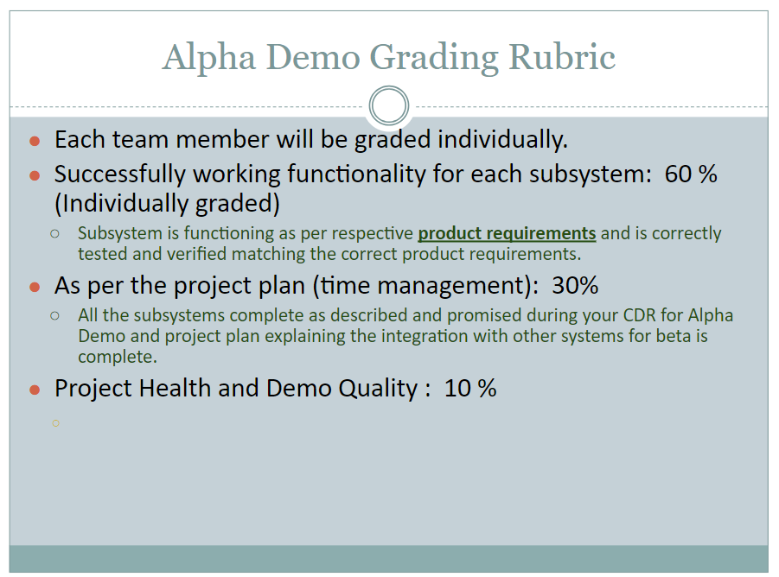
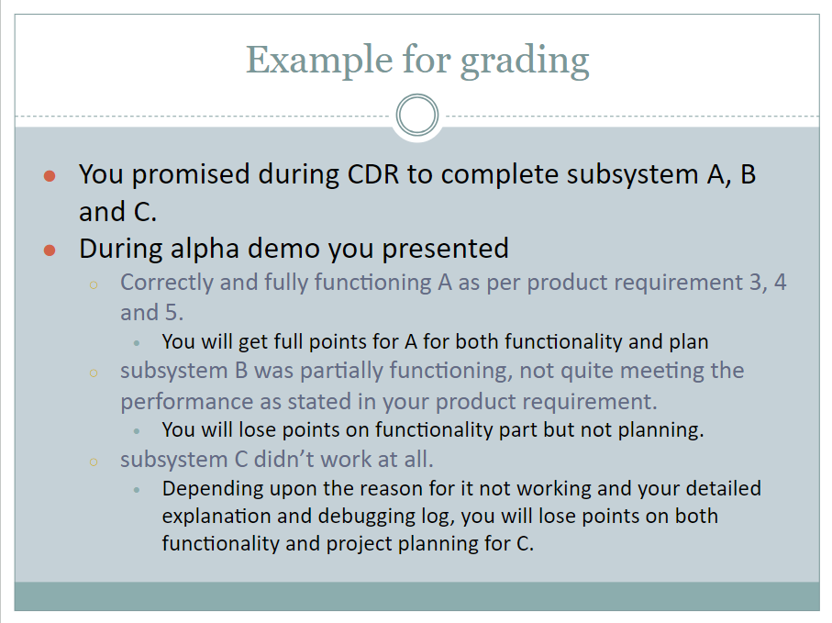
Presentations and demos need to be under 20 minutes total to leave time for questions
Order of presentation
Intro - name (can read off speaker notes) 30 seconds
Product requirements alpha plan - name (go to spreadsheet) 1 minute
Subsystem demos - about 4 minutes each
Product requirements beta plan - name (go to spreadsheet) 1 minute
Questions from profs. - about 10 min

Slide 3
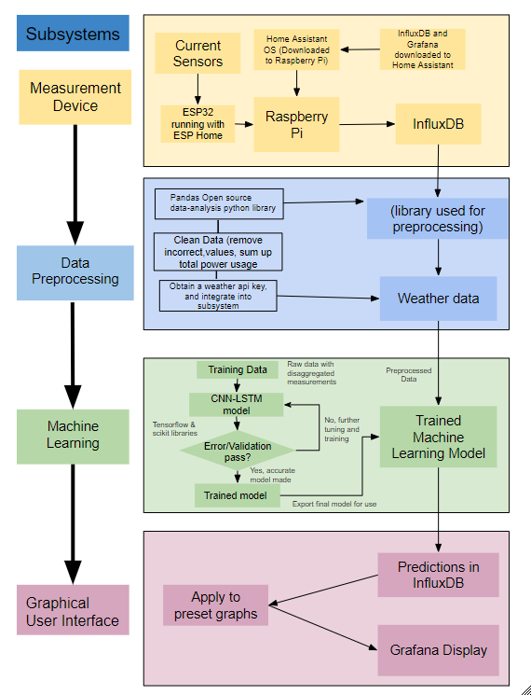
Project Introduction (Alpha Demo)
Residential Power Disagreggation - Team 50
Team: Andrew Bailey, Ralph Cullom, Manny Harris, Labib Kasim
Sponsor: Huangjie Gong (ABB)
Key features:
Device measures lumped power usage of a household.
Data is wirelessly transmitted to a database
Weather data is added
Machine learning algorithm disaggregates loads
Information is displayed to the user
Key Requirements:
Inexpensive
Size
User interface
Target Customers
Homeowners & Property Managers
Notes:
Manny
Key Features
Our device measures the total power usage of a household and then uses software to predict how much power each individual appliance used before displaying that info to the user. After using current transformers to measure the total power, the measurements are wirelessly sent to a database. Then, a weather API adds the temperature for the time the measurement was taken, and a machine learning algorithm disaggregates the total power into separate loads. After this is done, the total and disaggregated loads are displayed to the user on a graphical interface
Key Requirements
Inexpensive - Our project differs from other devices in price, with an estimated final cost of the product under $100.
Size - device shall be small enough to fit inside a residential distribution panel
User interface - The user should be able to comprehend the data displayed without a technical background
Target Customers & Usage
Homeowners using this device will be able to understand their power usage and can find which appliances may be upgraded to save money on their electricity bill. Property managers could do this on a much larger scale if they have multiple housing units they maintain
Yellow stoplight
Having some issues connecting ESP32 to network, should be able to resolve this issue fairly easily
Have a weather API that can pull temperature history between a set of dates, unable to add temperature column to training data

Slide 4
Product Requirements
Demo Plan
Alpha Demo Test Plan
Beta Demo Test Plan

Slide 5
Subsystem Demos

Slide 6
Data Communication
Manny

Slide 7
Machine Learning - Model & Data Handling
Andrew

Slide 8
Website/UI
Ralph

Slide 9
Machine Learning - Weather API & Data Preprocessing
Labib

Slide 10
Questions
and
Discussion
Notes:
Slide template from slides.com

